Slide 1
Apps for SAP Project and Portfolio Management
Milliarum App: PPM approval and processing of decision points

Slide 2
About Milliarum
• We focus our consulting and development on system solutions for SAP Project Management since the company was founded in 2006
• Our solutions are based on the SAP® Project System and SAP® EPPM
• Our focus is on Project Management, Product Development, customised production and resource management processes
• The aim of our solutions is to create efficient, cost-effective and therefore competitive business processes for our customers
• With the Milliarum Cockpit (MC) and its content packages, as well as the Milliarum Apps we have standardised software products that "close the gaps" in SAP's standard software for Project Management.

Slide 3
Overview of Milliarum Apps
• Standardised UI5 or Web Dynpro apps "for quick usage„
• "Modern" and simple User Interface
• Can be used immediately due to preconfigured scope of delivery
• Access via Fiori Launchpad/SAP Business Client/URL
• Runs with PPM 6.1/ERP EHP8 and SAP_UI 7.54 or higher and for all S/4HANA releases
• Delivery as transport
• Language versions: German and English
• Licence model with maintenance/support (17% annually)
• Customised expansion options
• Interface customisation as part of the SAP infrastructure (SAP UI5 flexibility, Web Dynpro configuration)
• Marketing/Sales via Milliarum website (Apps area)
• Ticket system for customer reports via Mantis

Slide 4
Apps for EPPM Decision Points
Functional scope
• Dashboards for decision points with different selections
• Customising detail screen (object page) for decision point
• Changing the status of a decision point▪ Changing data for decision point
Requirements
• Fiori Launchpad
Benefits
• Cross-element selection of decision points according to different criteria
• Modern/simple App for decision point processing

Slide 5
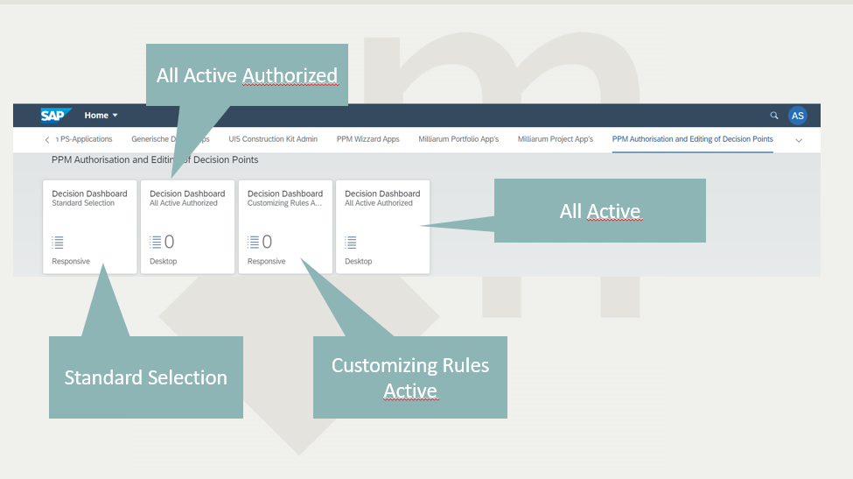

Slide 6
Functional scope: 8 Apps
App | Dashboard selection with Authorisation | UI5 Dashboard | Object Page
1a, 1b | All Decision Points | Responsive Table (tablet and smartphone) and/or Desktop table | Display and change SAP Standard fields, Customer fields, Status, Notes and Documents
2a, 2b | All items for decision points | Responsive Table (tablet and smartphone) and/or Desktop table | Display and change SAP Standard fields, Customer fields, Status, Notes and Documents
3a, 3b | All decision points pending to be decided with status in Customising | Responsive Table (tablet and smartphone) and/or Desktop table | Display and change SAP Standard fields, Customer fields, Status, Notes and Documents
4a, 4b | All decision points pending to be decided with status group "Approved" | Responsive Table (tablet and smartphone) and/or Desktop table | Display and change SAP Standard fields, Customer fields, Status, Notes and Documents

Slide 7
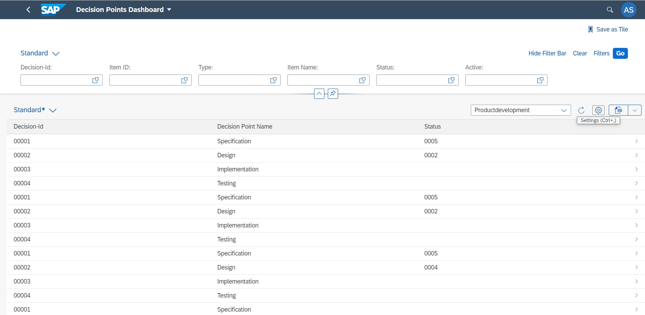
App Decision Points Dashboard I: Responsive
1. Dashboard with Portfolio item and Decision point data
4. Call detail screen
2. Current decision point
3. Current decision point status

Slide 8
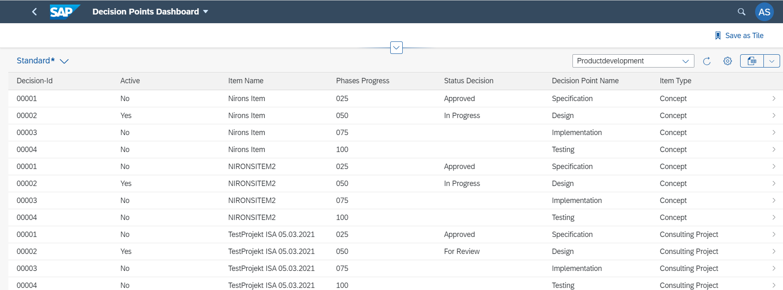
App Decision Points Dashboard II: Desktop
1. Dashboard with Portfolio item and Decision point data
4. Call detail screen
2. Current Decision point status

Slide 9
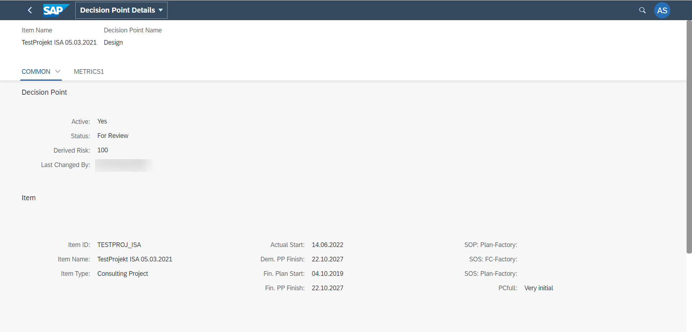
App Decision Points Object Page I
3. Metric data of the element
1. Layout in Groups via customising
2. Standard and customised SAP customer fields of the decision point

Slide 10
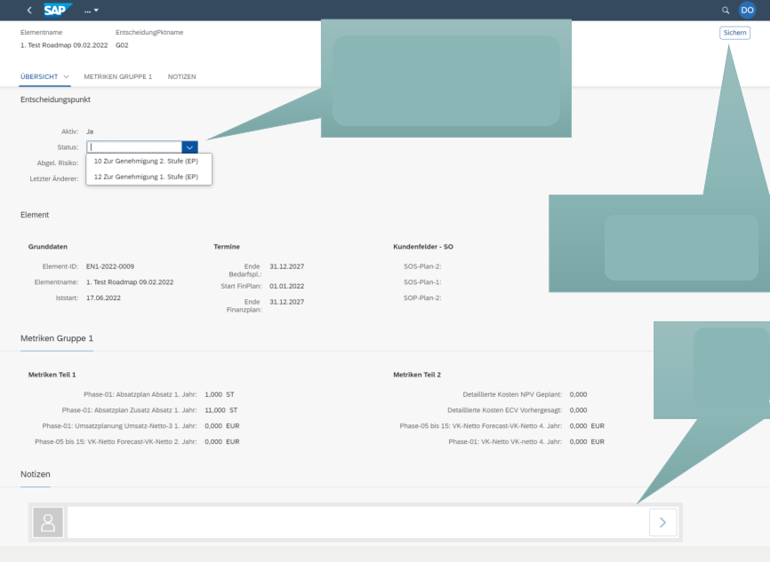
App Decision Points Object Page II
1. Selection next status of the decision point
3. Save changes
2. Recording comments on the decision point

Slide 11
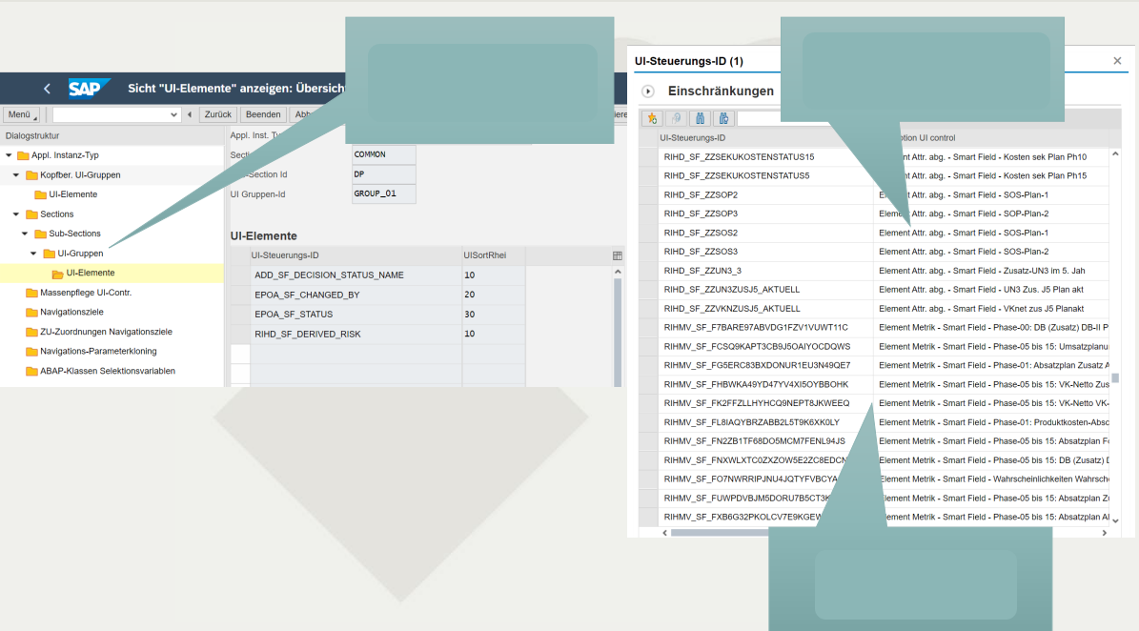
App Decision Points Object Page: Customising
1. Layout in sections/groups via customising
2. SAP standard and customer fields for selection
3. Metric data for the element

Slide 12

Contact & Sales
We are happy to answer your questions or provide you a non-binding offer directly. Use our licence calculator at www.milliarum.de under Apps or send us the following data to info@milliarum.com:
• Desired edition
• Number of users and developer licences
• SAP release and SAP UI version used
You will receive a software contract from us including maintenance and support.
After signed contract and receipt of payment, the software will be delivered by transport.
Milliarum GmbH & Co.KG
An der Eickesmühle 22
41238 Mönchengladbach
Tel.: +49 (0) 2166 3101 106
www.milliarum.de

