Slide 1
Apps for SAP Project and Portfolio Management
Milliarum App: PPM Task dashboard

Slide 2
About Milliarum
• We focus our consulting and development on system solutions for SAP Project Management since the company was founded in 2006
• Our solutions are based on the SAP® Project System and SAP® EPPM
• Our focus is on Project Management, Product Development, customised production and resource management processes
• The aim of our solutions is to create efficient, cost-effective and therefore competitive business processes for our customers
• With the Milliarum Cockpit (MC) and its content packages, as well as the Milliarum Apps we have standardised software products that "close the gaps" in SAP's standard software for Project Management.

Slide 3
Overview of Milliarum Apps
• Standardised UI5 or Web Dynpro apps "for quick usage„
• "Modern" and simple User Interface
• Can be used immediately due to preconfigured scope of delivery
• Access via Fiori Launchpad/SAP Business Client/URL
• Runs with PPM 6.1/ERP EHP8 and SAP_UI 7.54 or higher and for all S/4HANA releases
• Delivery as transport
• Language versions: German and English
• Licence model with maintenance/support (17% annually)
• Customised expansion options
• Interface customisation as part of the SAP infrastructure (SAP UI5 flexibility, Web Dynpro configuration)
• Marketing/Sales via Milliarum website (Apps area)
• Ticket system for customer reports via Mantis

Slide 4
Milliarum WebDynpro Apps: General conditions
• Delivery via transport requests (development/customising) based on separate Scenarios/Roles in the Milliarum Cockpit
• Single call as "SingleService" by entering the project number
• Instructions for embedding the App in the PPM project dashboard
• Customising environment for defining the app
• Prerequisite: at least PPM 6.1 or S/4HANA EPPM 1.0
• Licensing via User with a maintenance contract

Slide 5
Apps for EPPM Projects - PPM Task Dashboard
Functional scope
• Display all tasks (Admin view)
• Task display not dependent on the release status
• Jumps to Task, Project Details and Task Confirmation
• Limitation of search criteria via the Filter Bar
Requirements
• At least SAP Portfolio and Project Management 6.1 (PPM 6.1) or SAP Portfolio and Project Management 1.0 for S/4 HANA (EPPM 1.0)
Benefits
• Significantly faster evaluation than in the SAP Standard, especially for monitoring tasks in a specific project

Slide 6
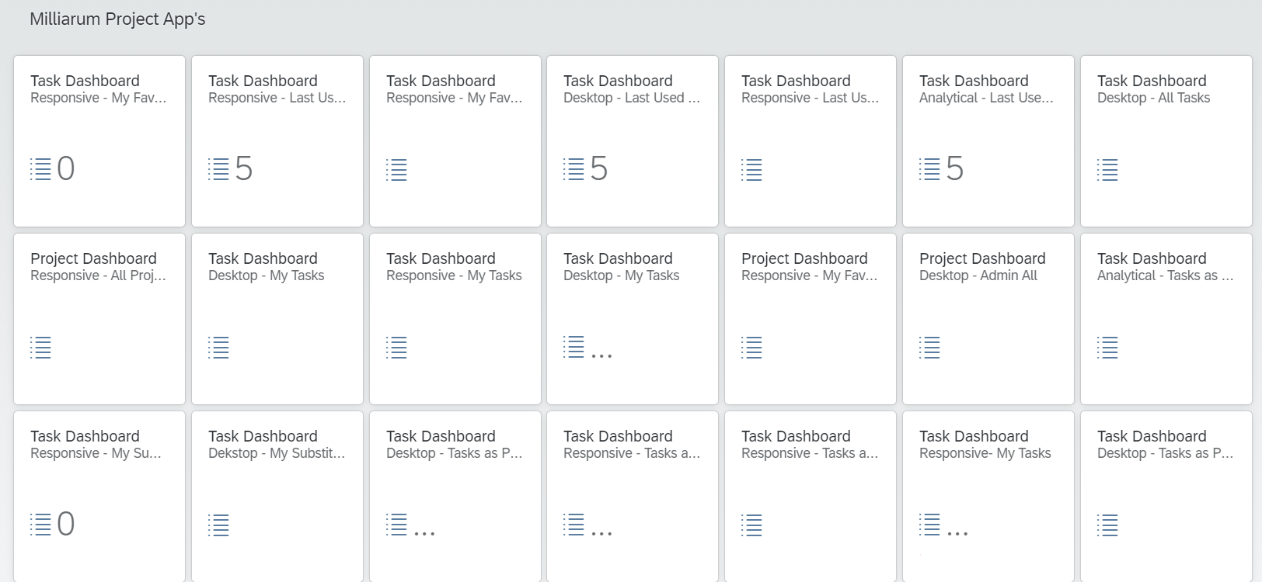
App Task Dashboard I: Tile overview
1. Overview screen of all added Tiles (one Responsive and one Desktop version each)
4. All Tasks
3. Last Used Tasks
2. My Favourites
5. My Tasks
7. My Tasks as Project Manager
6. My Substitute tasks (Analytical)

Slide 7
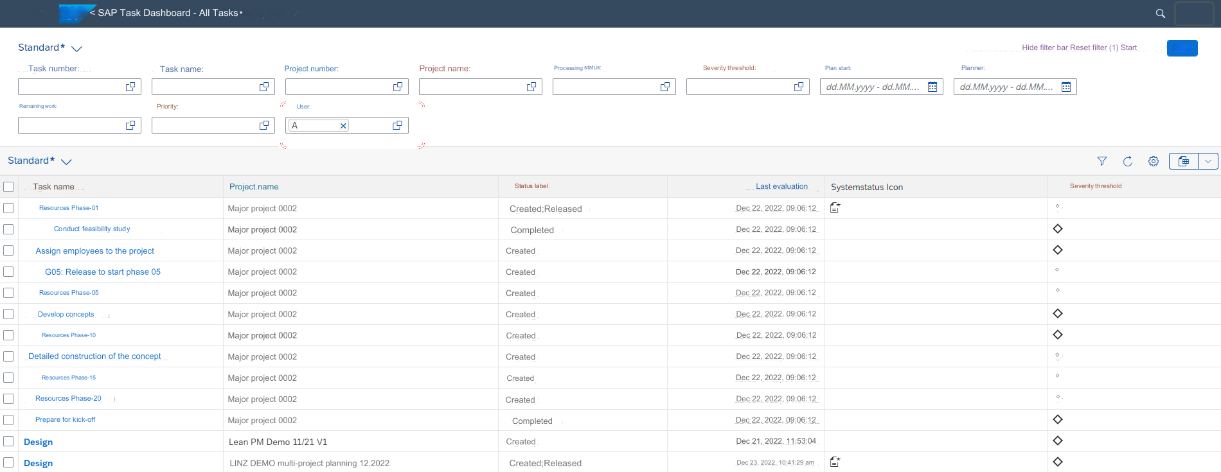
App Task Dashboard II: "My tasks"
3. Hide Filter Bar
5. Actions such as "Show and hide Filter Bar", "Refresh", "Settings"
4. Excel-Export
1. Overview screen of all tasks
2. Project Name

Slide 8
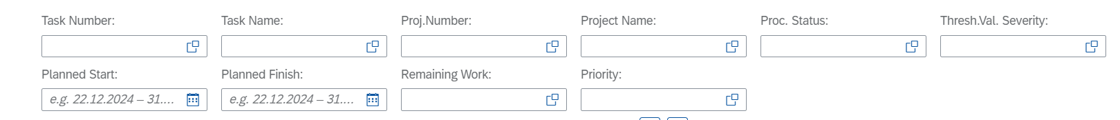

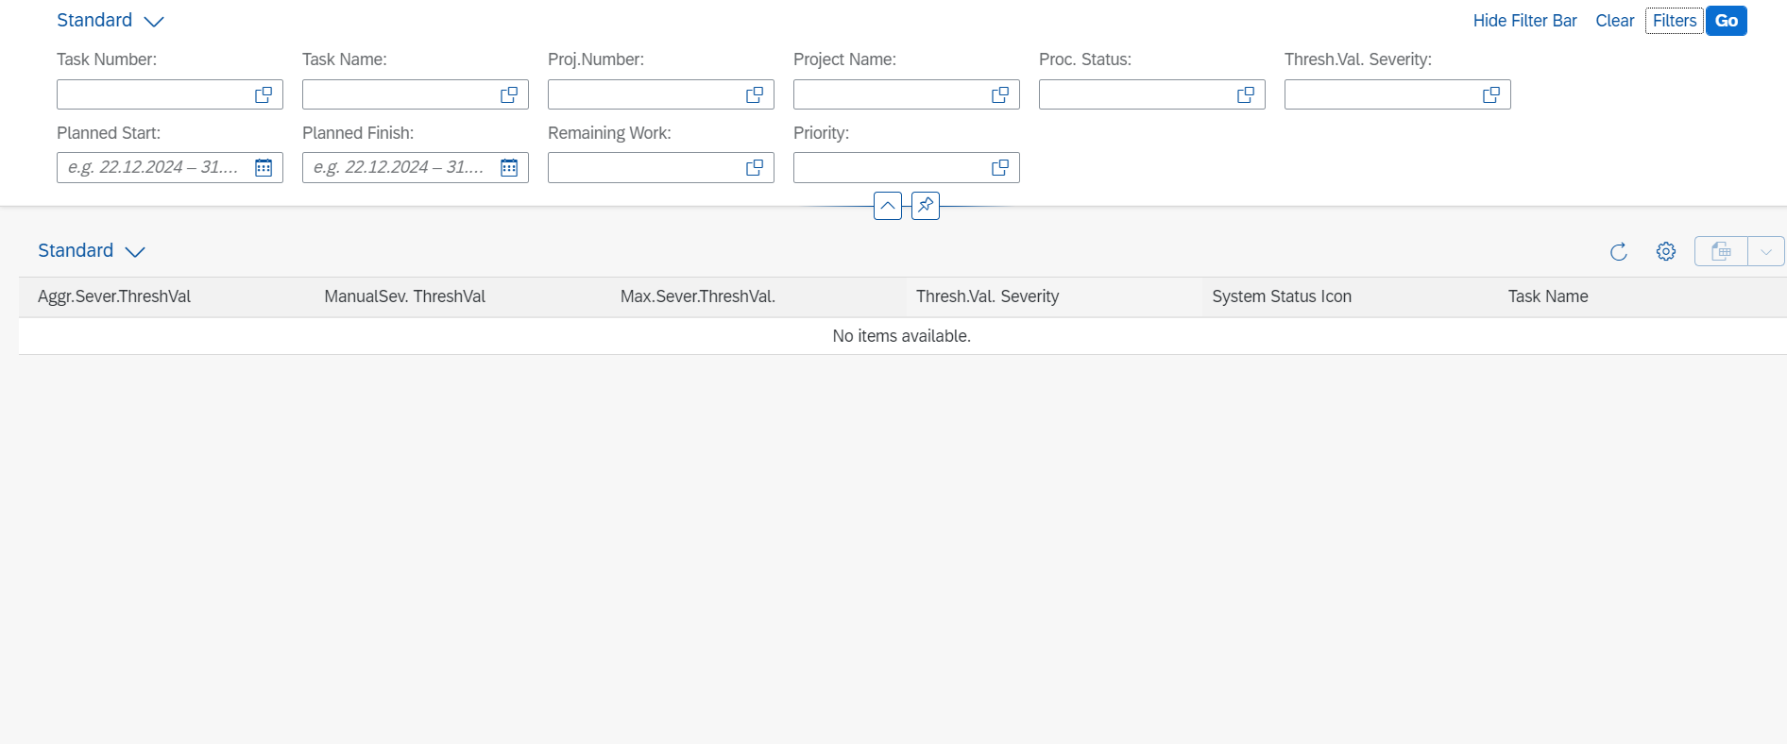
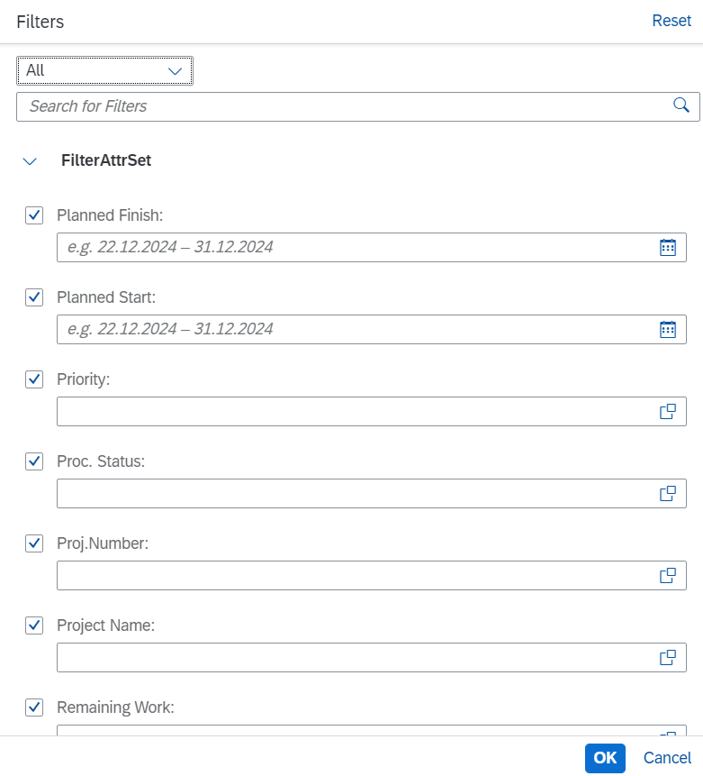
App Task Dashboard III: Filter Bar
1. Individual Filter options
4. Hide Filter Bar
3. Planned Start / Planned Finish
5. Filter selection
2. Search in the Filter

Slide 9
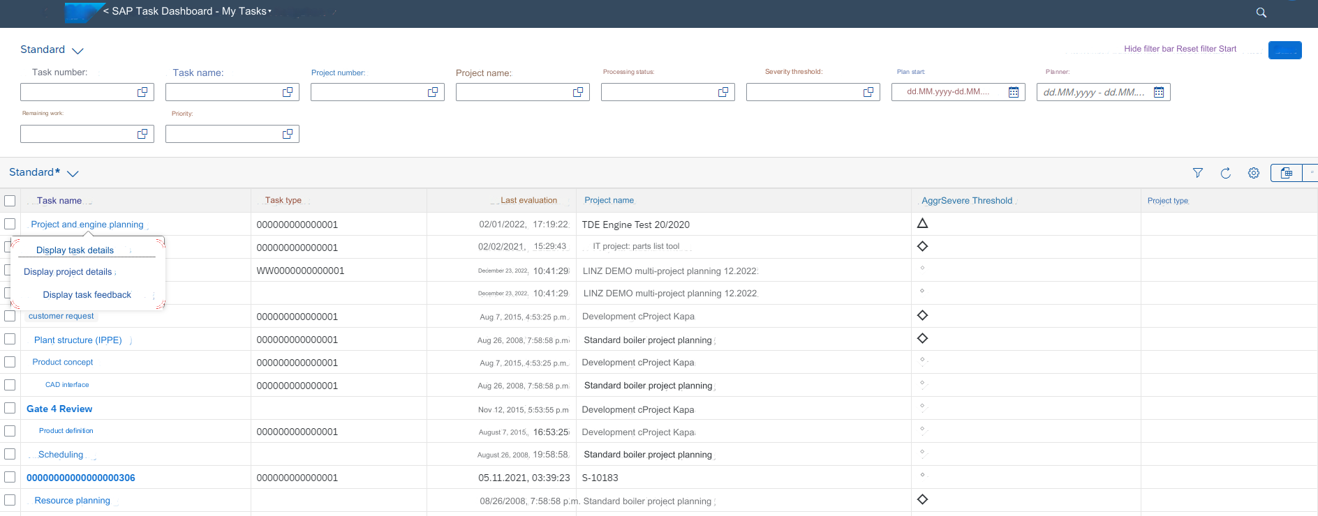
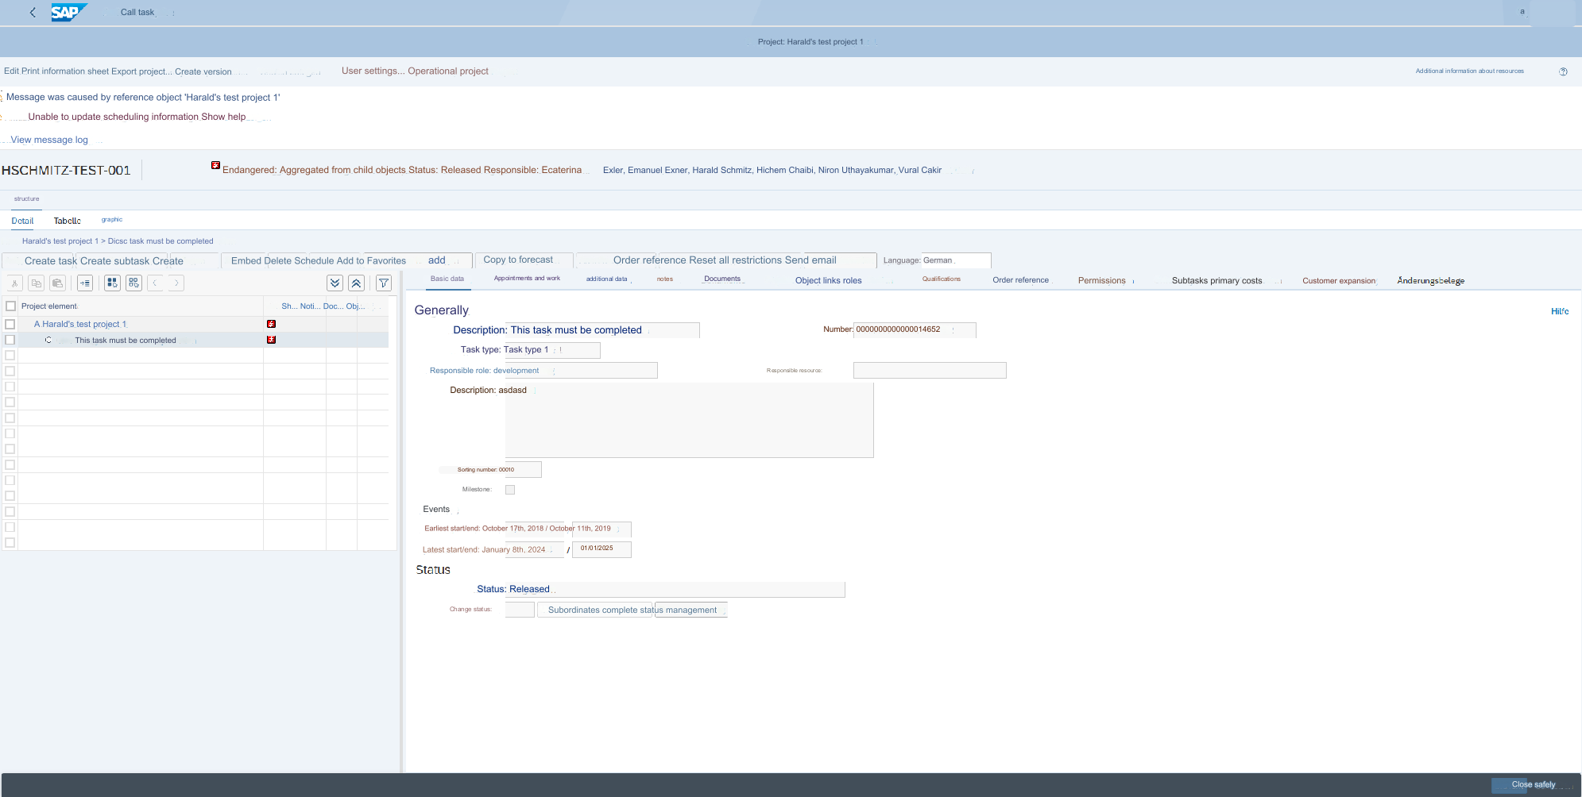
App Task Dashboard IV: Jumps into WebDynpro application
2. Jump to WebDynpro
1. Jump options: Task details, Project details, Task feedback

Slide 10

Contact & Sales
We are happy to answer your questions or provide you a non-binding offer directly. Use our licence calculator at www.milliarum.de under Apps or send us the following data to info@milliarum.com:
• Desired edition
• Number of users and developer licences
• SAP release and SAP UI version used
You will receive a software contract from us including maintenance and support.
After signed contract and receipt of payment, the software will be delivered by transport.
Milliarum GmbH & Co.KG
An der Eickesmühle 22
41238 Mönchengladbach
Tel.: +49 (0) 2166 3101 106
www.milliarum.de

