Slide 1
Apps for SAP Project and Portfolio Management
Milliarum App: PPM Staffing overview

Slide 2
About Milliarum
• We focus our consulting and development on system solutions for SAP Project Management since the company was founded in 2006
• Our solutions are based on the SAP® Project System and SAP® EPPM
• Our focus is on Project Management, Product Development, customised production and resource management processes
• The aim of our solutions is to create efficient, cost-effective and therefore competitive business processes for our customers
• With the Milliarum Cockpit (MC) and its content packages, as well as the Milliarum Apps we have standardised software products that "close the gaps" in SAP's standard software for Project Management.

Slide 3
Overview of Milliarum Apps
• Standardised UI5 or Web Dynpro apps "for quick usage„
• "Modern" and simple User Interface
• Can be used immediately due to preconfigured scope of delivery
• Access via Fiori Launchpad/SAP Business Client/URL
• Runs with PPM 6.1/ERP EHP8 and SAP_UI 7.54 or higher and for all S/4HANA releases
• Delivery as transport
• Language versions: German and English
• Licence model with maintenance/support (17% annually)
• Customised expansion options
• Interface customisation as part of the SAP infrastructure (SAP UI5 flexibility, Web Dynpro configuration)
• Marketing/Sales via Milliarum website (Apps area)
• Ticket system for customer reports via Mantis

Slide 4
Milliarum WebDynpro Apps: General conditions
• Delivery via transport requests (development/customising) based on separate Scenarios/Roles in the Milliarum Cockpit
• Single call as "SingleService" by entering the project number
• Instructions for embedding the App in the PPM project dashboard
• Customising environment for defining the app
• Prerequisite: at least PPM 6.1 or S/4HANA EPPM 1.0
• Licensing via User with a maintenance contract

Slide 5
Apps for EPPM Projects - App PPM Staffing Overview
Functional scope
• Flexible selection of Capacity Requirements e.g. via status or projects within the User/Resource Manager
• Quick entry of requirements via Excel and/or Distribution function
• Download and upload via Excel templates
• Display of availability data during employee scheduling
• Mass processing function (e.g. setting the processing status, deleting assignments, change periods of staffing assignment)
Requirements
• User defined as Resource Manager in PPM
• Additional field organisational unit for PPM Role
Benefits
• Significantly faster processing compared to SAP Standard
• Usage of Excel templates/distribution functions for faster planning of role requirements

Slide 6
Overal resource management proccess (within SAP PPM-Project and Milliarum Multi-Project Role Planning)
1
Capacity offering
Project (Project management)
Cost centre (Resource management)
Demand planning and adjustment
- Division according to roles/tasks
→ Project management reports a need for the “Engineering” role from May to June with a budget of 300 hours
Employee deployment planning
The PL/resource manager checks the requirements and plans the employees/resources
→ Ms. Schulz and Mr. Meier will be assigned to the registered requirement for the “Engineering” role
PPM Project Management and Milliarum Multi-Project role planning
2
3
Checking the hours to adjust the requirements planning
The project management carries out plausibility checks at the “role/task level”.
- Any abnormalities are clarified through dialogue
Hourly recording and approval
Ms. Schulz and Mr. Meier report back their hours
The PL/Resource Manager approves this
5
4
6
Evaluation/Simulation

Slide 7
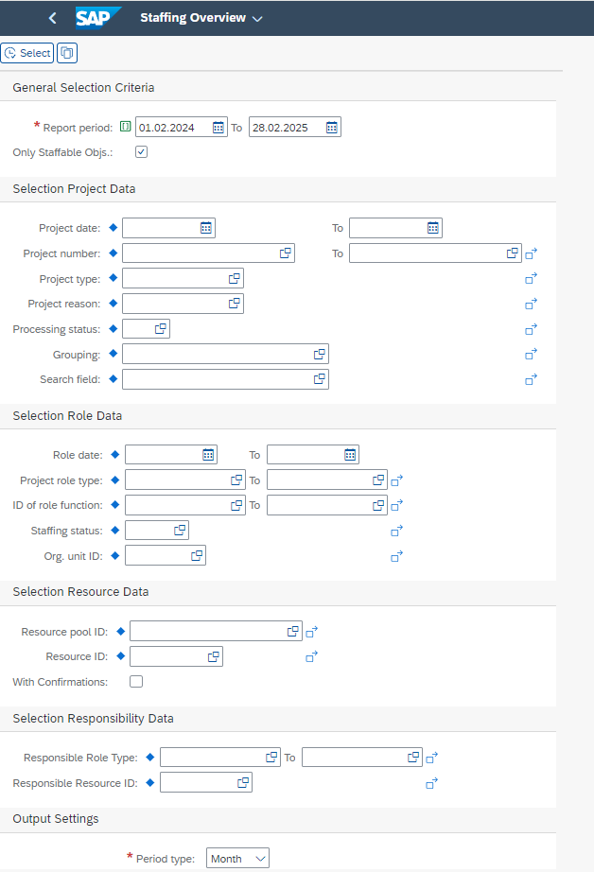
PPM Staffing Overview: Selection Screen
1. Pre-assignment through selection criteria
2. Selection Project Data
3. Selection through Role Data in the Project
4. Selection of Resource data in the Project
5. Selection across all projects of a project manager
6. Output Settings

Slide 8
PPM Staffing Overview: Employee Assignments
1. Function for editing/display
2. Progress indicator for the cast status of the role (can be set via customising)
3. Maintenance of requirements for employee assignments
4. Customisable display of object data

Slide 9
PPM Staffing Overview: Extended scheduling function
1. General Role informantion
2. Requirements information on the role
4. Colouring of the cells via customising depending on the availability in %
3. Employee‘s availability data

Slide 10
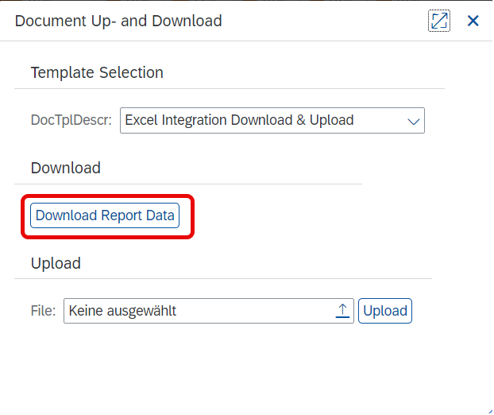
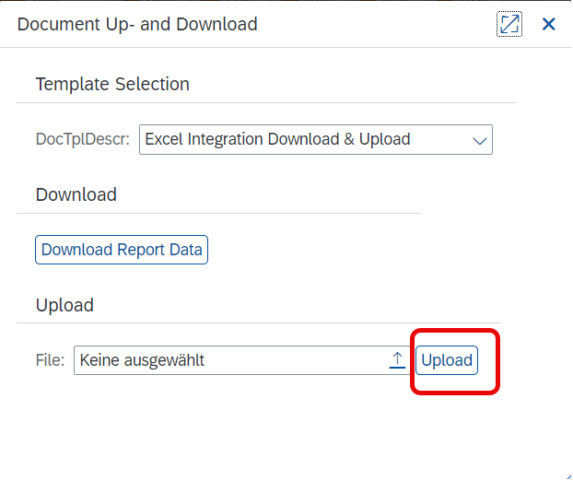
Excel Integration: Data input via Excel
1
Download the staffing overview
1
2
Enter data in Excel
3
Import entered data into the staffing overview
1
3
2

Slide 11
Mass processing functions: Delete staffing
1. Select the function

Slide 12
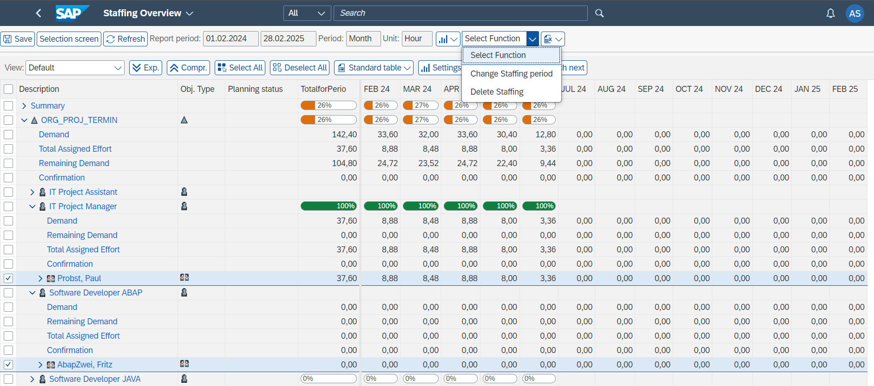
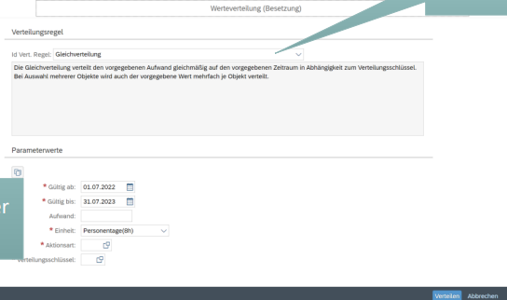
Mass processing functions: Distribution of values via "Distribution Rules"
2. Selection of the function
3. Selection of the distribution rule
1. Multiple marking of the resources
1. Multiple marking of the resources

Slide 13
Contact & Sales
We are happy to answer your questions or provide you a non-binding offer directly. Use our licence calculator at www.milliarum.de under Apps or send us the following data to info@milliarum.com:
• Desired edition
• Number of users and developer licences
• SAP release and SAP UI version used
You will receive a software contract from us including maintenance and support.
After signed contract and receipt of payment, the software will be delivered by transport.
Milliarum GmbH & Co.KG
An der Eickesmühle 22
41238 Mönchengladbach
Tel.: +49 (0) 2166 3101 106
www.milliarum.de

