Slide 1
Apps for SAP Project and Portfolio Management
Milliarum App: PPM Portfolio elements multi-overview page

Slide 2
About Milliarum
• We focus our consulting and development on system solutions for SAP Project Management since the company was founded in 2006
• Our solutions are based on the SAP® Project System and SAP® EPPM
• Our focus is on Project Management, Product Development, customised production and resource management processes
• The aim of our solutions is to create efficient, cost-effective and therefore competitive business processes for our customers
• With the Milliarum Cockpit (MC) and its content packages, as well as the Milliarum Apps we have standardised software products that "close the gaps" in SAP's standard software for Project Management.

Slide 3
Overview of Milliarum Apps
• Standardised UI5 or Web Dynpro apps "for quick usage„
• "Modern" and simple User Interface
• Can be used immediately due to preconfigured scope of delivery
• Access via Fiori Launchpad/SAP Business Client/URL
• Runs with PPM 6.1/ERP EHP8 and SAP_UI 7.54 or higher and for all S/4HANA releases
• Delivery as transport
• Language versions: German and English
• Licence model with maintenance/support (17% annually)
• Customised expansion options
• Interface customisation as part of the SAP infrastructure (SAP UI5 flexibility, Web Dynpro configuration)
• Marketing/Sales via Milliarum website (Apps area)
• Ticket system for customer reports via Mantis

Slide 4
App for PPM Portfolio items Overview Page
Functional scope
• Display of PPM portfolio item dashboard data in a modern Fiori interface
• Graphical and/or tabular representation of portfolio items in cards
• Customising for the definition of cards
• Delivery of over 10 preconfigured cards
• Jump to Single Item Overview Page* and SAP Standard PPM functions
Requirements
• Fiori Launchpad
• Customising the portfolio item dashboard in SAP PPM
Benefits
• Graphical representation of the most important key figures for portfolio items
• Online evaluation of the portfolio item data

Slide 5
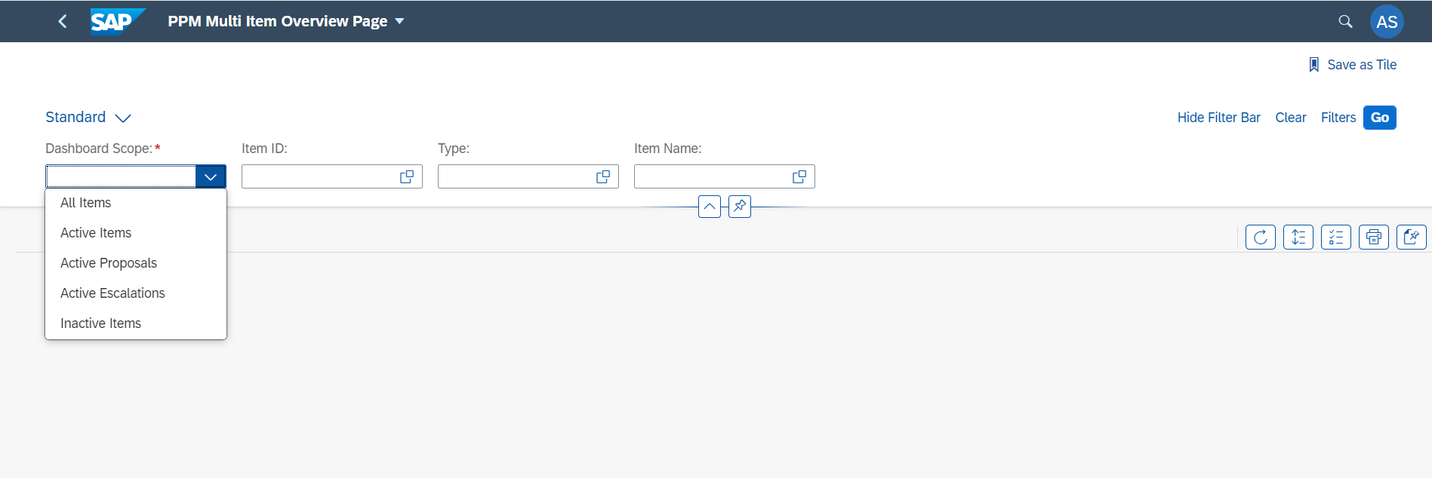
App PPM Portfolio Elements Overview Page
Selection screen
2. Restriction of the dashboard data
1. Selection the dashboard scope to display data

Slide 6
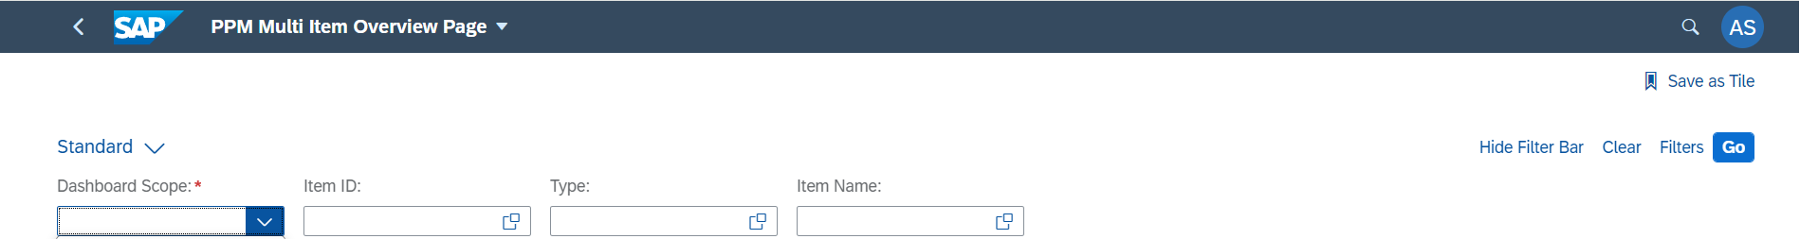
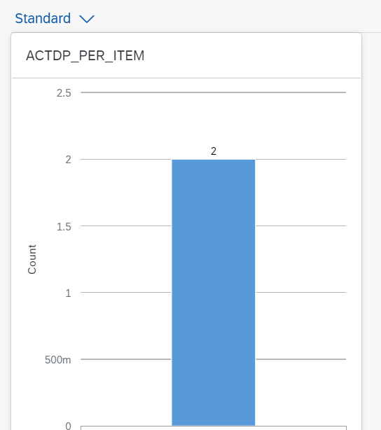
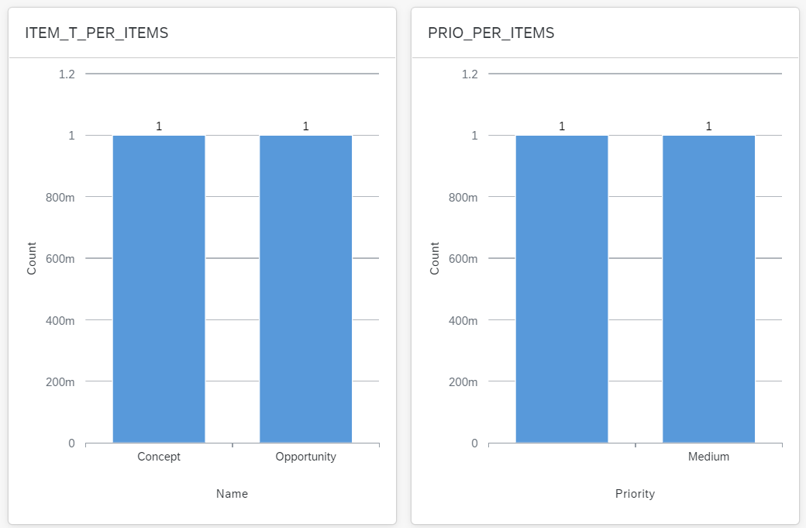
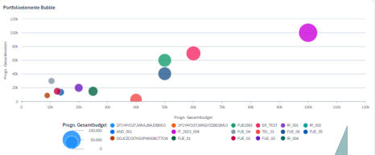
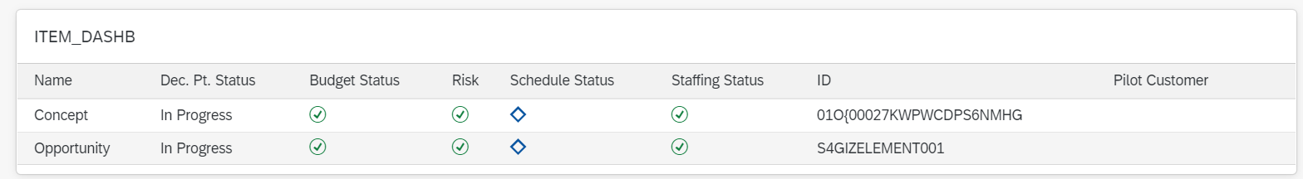
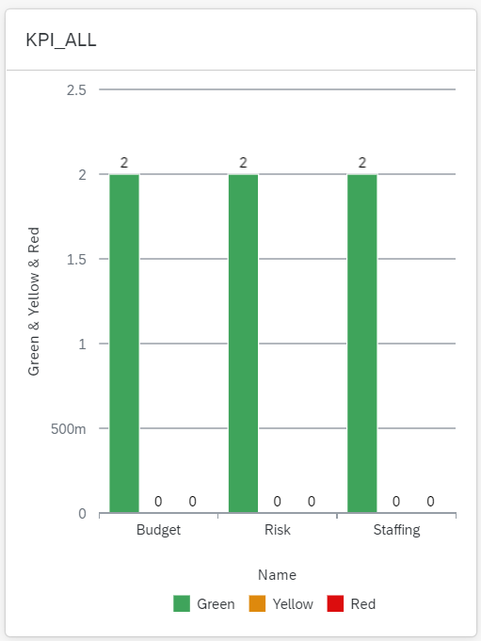
App PPM Portfolio Elements Overview Page
Result
Graphic cards
Tabular cards

Slide 7
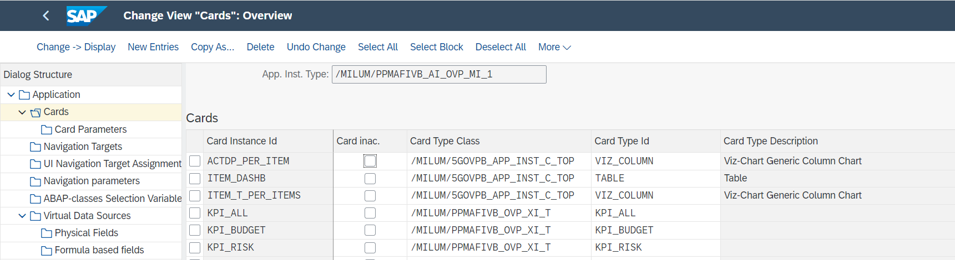
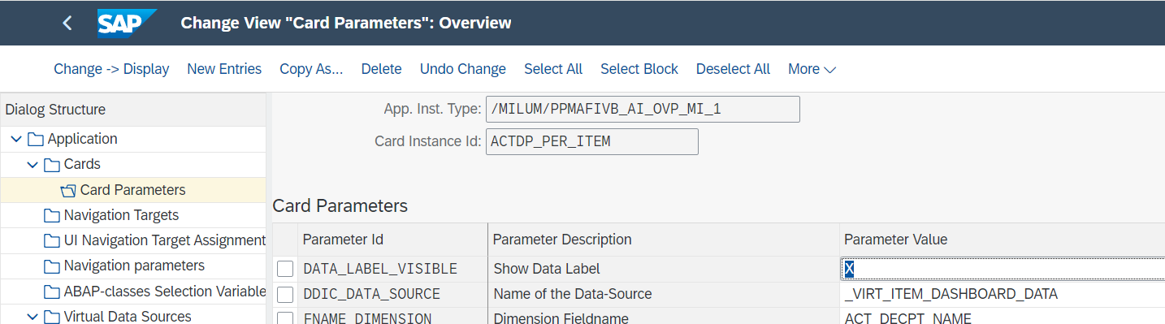
App PPM Portfolio Elements Overview Page
Customising
Detail customising depending on the Card/Graphic type
Definition of the cards in customising

Slide 8

Contact & Sales
We are happy to answer your questions or provide you a non-binding offer directly. Use our licence calculator at www.milliarum.de under Apps or send us the following data to info@milliarum.com:
• Desired edition
• Number of users and developer licences
• SAP release and SAP UI version used
You will receive a software contract from us including maintenance and support.
After signed contract and receipt of payment, the software will be delivered by transport.
Milliarum GmbH & Co.KG
An der Eickesmühle 22
41238 Mönchengladbach
Tel.: +49 (0) 2166 3101 106
www.milliarum.de

